Slide 1
BABC Texas Annual General Meeting & Member Appreciation
WELCOME
James McLennan, BABC Texas President

Slide 2
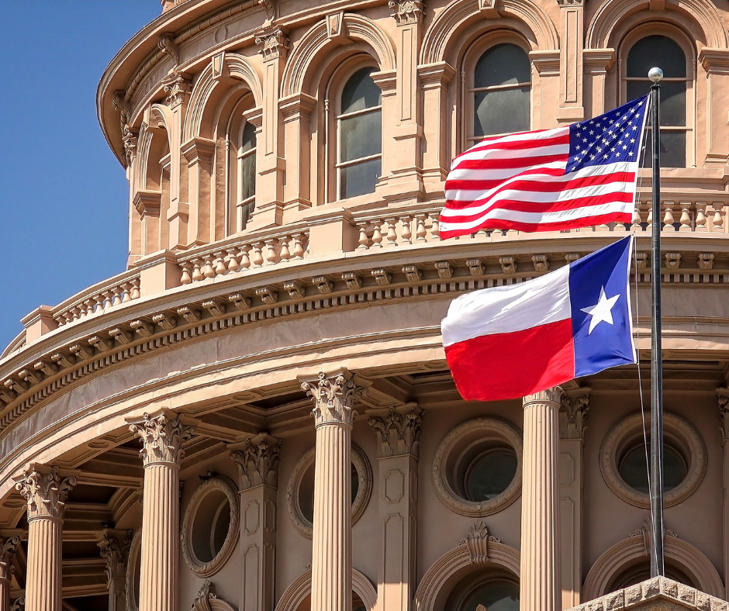
Agenda
5:30pm
Welcome & Introductions
BABC Texas Snapshot
What’s Coming Up?
Getting Involved – making the most of your membership
6:00pm
Board member election
6:15pm
Fireside chat with Richard Hyde and Adriana Cruz
7:00pm
Networking
7:30pm
Event closes

Slide 3
3
3

Slide 4
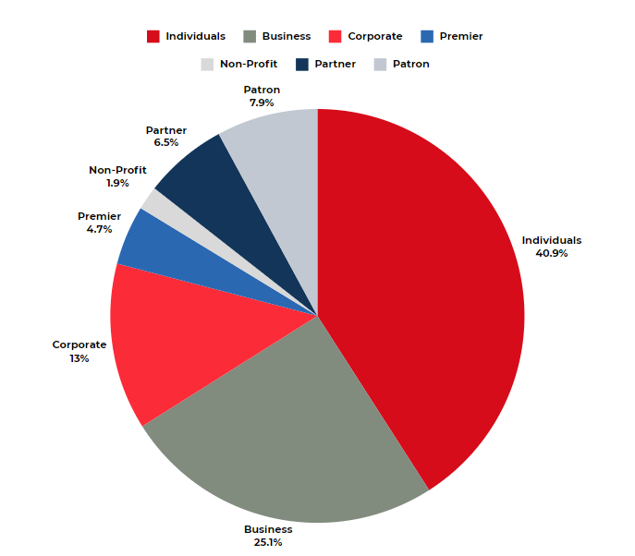
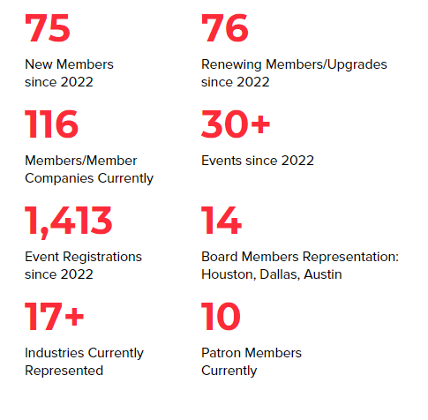
BABC Texas Snapshot
Feb 13th
2022 - 2024
4

Slide 5
Our Patron Members

Slide 6
Industries and Events
Just some of the industries represented:

Slide 7
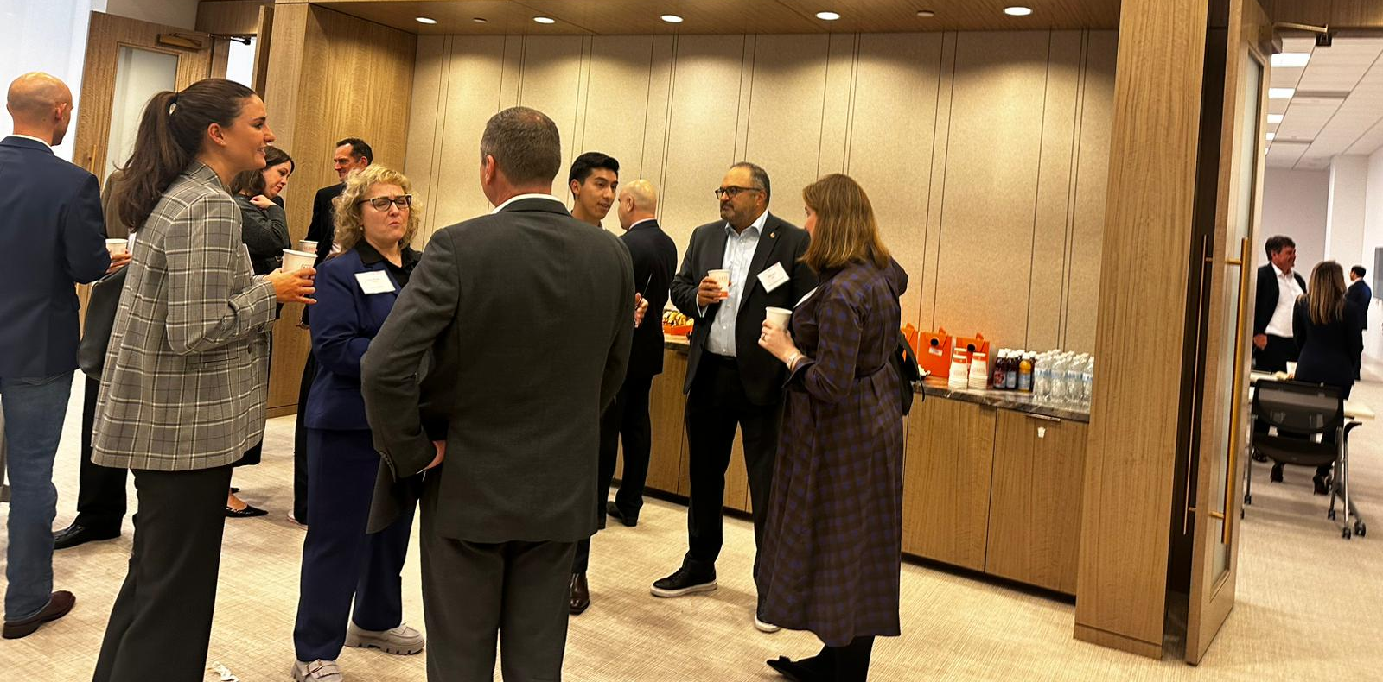
2024 Event Outlook
What’s Coming Up?
Jan & Feb
New Year HH & AGM
March
Happy Hour, Postinos
Social “British Themed” night at the Dynamos
April
Executive Roundtable: Political Outlook - Steptoe & Johnson
Immigration & Employment Law Update - Jackson Walker
May
Multinational Monday HH
AI & Cyber Panel - KPMG
June
BABC Texas Theatre Night – Main Street Theatre
September
BABN Members Transatlantic Conference; Charlotte, NC
November
Energy Outlook – S&P Global
Commonwealth HH
December
Christmas Curry at Kiran’s
tentative events
7

Slide 8
Getting Involved
Individual Members
Attend events / Network
Volunteer at an event
Business Members +
Attend events / Network
Volunteer at an event or get involved in a committee
Member Spotlight
Sponsor an event
Share your news with us
Ask for introductions
Host an event / join a panel

Slide 9
2024 Board Member Election
Each nominee has been endorsed by five members, in good standing, and has been given a vote of confidence by the Board of Directors
Each member, or member company, will have one vote, per nomination
We present this slate of six current directors who are seeking reelection and one board member for ratification, following election at our last board meeting in October.
Reelection:
Kevin West - 1 year term
Sian Mikkelsen - 1 year term
Mary McIntyre - 2 year term
Lee-Anne Cottle - 2 year term
Kay Thomson - 3 year term
James Prappas - 3 year term
Ratification:
Jon Braham – 1 year term

Slide 10
THANK YOU!
Please welcome our special guests:
- His Majesty’s Consul General in Texas, Richard Hyde
- Executive Director TED&T, Adriana Cruz

