Slide 2
Justin Hoffman
Chief Executive Officer
cSolutions
Justin is second-generation Oil & Gas from Aberdeen, Scotland. He has lived and worked in the UK, Scandinavia, Southeast Asia and the US, which has afforded him the opportunity to travel extensively across these and other regions.
The majority of his career has been focused on bringing products, technologies, and services to market while working collaboratively with vendor and client partners for deeper understanding and success at the project and operations level.
While still developing on his 25+ years of global experience in Oil & Gas, Justin has successfully transitioned to the renewable energy sector while bringing his network along with him. This includes developing collaborative domestic partnerships interested in bidding US Offshore Wind projects and presenting US supply chain options to increase the “Local Content” at international fabrication facilities.
As Houston Ambassador for Scottish Business Network and a GlobalScot, worldwide networks of entrepreneurial and inspirational business leaders, dedicated to supporting Scotland’s most ambitious companies, he’s passionate about the existing dynamics and future developments within the Energy Industry.

Slide 3
Chris Cooper
Chief Executive Officer
Cairn Enterprises
Chris is currently CEO of Cairn Enterprises LLC, a holding company that includes oil & gas, home services and hospitality business interests. Previous positions included CEO, Cadre Energy, a start-up oil & gas company as well as Chief Operating Officer, Amplify Energy/Memorial Production Partners, an oil & gas company with assets across the US. He previously worked for Marathon Oil for over 24 years in a variety of leadership, engineering, and project management roles in many geographic locations including; UK, US, Canada, Russia, Norway, and West Africa.
Chris is a trustee of Entrepreneurial Scotland (USA) and was appointed a Global Scot in 2013.

Slide 4
Kristie Caviness
Manager Employee Engagement & Community Outreach
Texas Workforce Commission
Kristie Caviness is the manager of the Employer Engagement and Community Outreach (EECO) team in the Office of Employer Initiatives (OEI). The EECO team is directly responsible for the Skills Development Fund (SDF), Self Sufficiency Fund (SSF), High Demand Job Training (HDJT) and Texas Industry Partnership (TIP). The primary goal for these grants is to connect businesses and our partners (community colleges, workforce boards, and TEEX) to provide the needed training for Texans to stimulate the Texas economy. Kristie brings over 25 years of extensive
experience in marketing, brand development/management, promotions, and corporate operations with proven leadership skills. She has worked for a variety of business types including economic development and the travel/tourism industry. A Texas Tech University graduate with a BA in Advertising &amp; Public Relations, she enjoys all things red and black! Kristie resides in Georgetown with her husband, Randall.

Slide 5
Mark Hannigan
Chief Executive Officer and Co- Founder
Moblyze
Based in Dallas TX, Mark is a globally accomplished business executive with 25 years in the energy/industrial sector where he built several successful companies with private equity backing. He is Chairman of Kestrel Group (Digital asset management), Partner at Greenbackers Investment Capital (ClimateTech funding advisory) and is CEO & co-founder of Moblyze (Energy Transition workforce app). An early champion of digitalization of the industrial sector.
Mark is also a trade ambassador for the Scottish Government and aMechanical PE.

Slide 6
Evelyn Maclean-Quick
Workforce Energy Taskforce Director & IOGP
Managing Director VIA Advisory Group
Executive Advisor Bain and Company
Evelyn MacLean is an energizing leader with deep expertise in culture shaping and business transformation who brings high caliber experience and processes to companies seeking enhanced performance through effective engagement. She is results oriented, and an alternative thinker who prizes people, relationships and smart, tech enabled organizations.
Evelyn is a former Chief Procurement Officer with over 30 years’ multi-cultural experience in the upstream oil and gas industry, holding accountability for multi-billion dollar third-party spend, ensuring safe and reliable operations. Former employers include Halliburton, bp and Hess Corporation. Areas of specialty include design and implementation of digital solutions to drive efficiency, lean and continuous improvement, strategic supplier relationship management, crisis management, business transformation programs with emphasis on human psychoanalysis.
Evelyn is a member of INSEAD Alumni, a member of CIPS, SPE, ICF, IMCUSA, UKATA and ISPSO, and is a Board Member for Bayou Companies. Qualifications include a master’s degree from INSEAD in Consulting and Coaching for Change, bachelor’s degree in Management from Bellevue University, law studies at Aberdeen University,
executive certificate in Management & Leadership from MIT-Sloan, certificate in Organizational
Transactional Analysis at The Berne Institute and Organizational Psychology at Inverness Technical
College.
Evelyn is also an ICF Certified Business and Personal Coach.

Slide 7
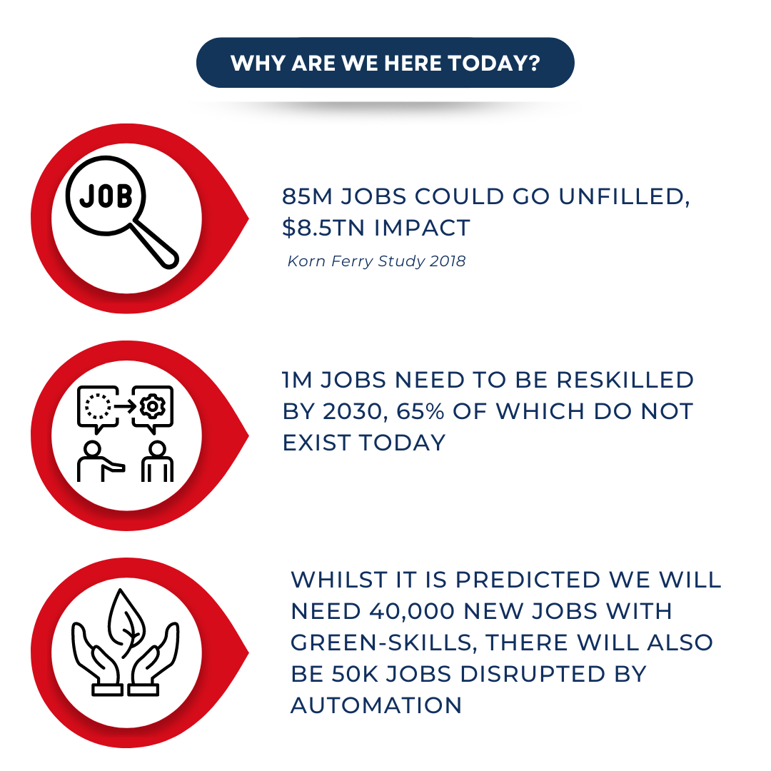

Slide 11
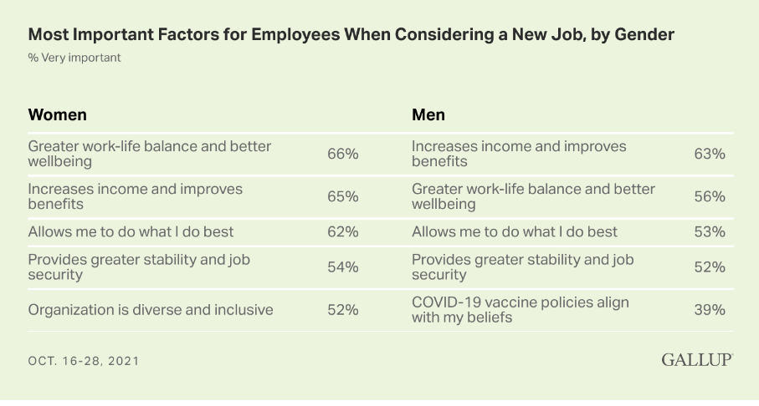

Slide 12
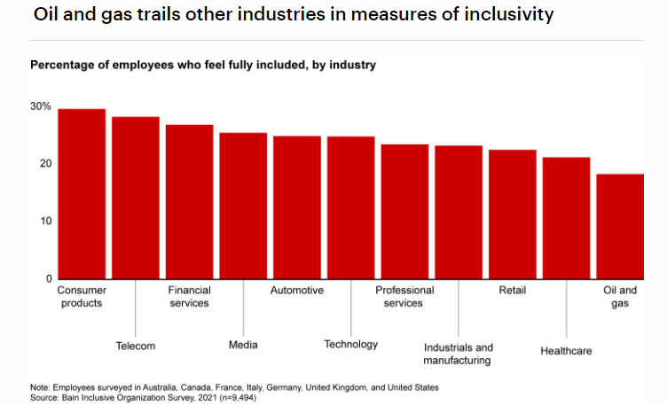

Slide 13
What Is The Data Telling Us?
Lack Of Employee Engagement
Employee Focus
Costs $7.8TN / 11% of GDP (1)
47% of the time is spent mind-wandering (5)
When multi-tasking, we lose up to 40 percent productivity as it takes the brain more time to switch from task to task and we make more errors than when focusing on one task at a time. (6)
Women in Business
Hold more senior executive positions in Utilities sector than elsewhere in Energy (2)
Are listed in < 11% of the patent applications in Energy Sector (2)
Despite making up 48% of the global labor force, women only account for 22% of the traditional energy sector (2)
Recruiting women takes more than competitive pay (3)
Leadership
Annual spend on leadership development ~$366BN (7)
EY study with Said Business School found that 85% of senior leaders have been involved in major transformations in past 5 years. Emotional toll is high. Most transformations involve lay-offs (8)
Gender Parity
It would take 30yrs to achieve gender parity within the industry (4)
SOURCES
Gallup State of the Global Workplace, 2022)
IEA
Gallup
OGUK 2021 report findings
(5) Harvard Psychologist Killingsworth Study, 2010
(6) MIT Neuroscientist Earl Miller
(7) TrainingIndustry.com
(8) ConsultancyUK

Slide 14
Workforce Skill Transferability
Recent RGU study
Around 80% of the jobs in 2030 are envisaged to be in nine key job families - Operations, Technicians, Engineering, Projects, Commercial/Business Development/Marketing, Procurement/Supply chain management, Finance, HR and HSE
Soft skills and other non-technical skills are generally highly transferable to adjacent energy sectors
Around 100,000 (c 50%) of the jobs in 2030 are projected to be filled by people transferring from existing oil and gas jobs to offshore renewable roles, new graduates and new recruitment from outside the existing UK offshore energy sector
With the increased energy system localization and the emergence of integrated regional energy clusters it is projected that the offshore energy workforce will become increasingly regionalized
Notes:
In the event there is any doubt about transferability of skills from traditional fossil fuel to renewables… this UK study by RGU offers some reassurance.

Slide 15
The Future Of Work: In-demand Skills By 2030
Higher cognitive- Advanced literacy and writing, critical thinking, and quantitative analysis and statistical skills
Social and emotional- Advanced communication, empathy, adaptable, and the ability to learn continuously
Technological- Basic to advanced IT skills, data analysis, and engineering. These future skills are likely to be the most highly paid
Source: McKinsey Global Institute
T-shaped students -Those with deep specialty knowledge as well as breadth in their mindset, with skills such as system thinking, collaborative methodologies and entrepreneurship
Source: Prof Deborah Terry AO, APPEA 2022
What can you do now?
Is your expertise being leveraged?
What are you willing to do about it?
Start learning and make it a habit.
Notes:
More on the theme of types of skills needed for the future... McKinsey Institute and University of Queensland Professor view… If you are listening today because things aren’t going well, suggest you reflect on these four themes on the right.

Slide 16
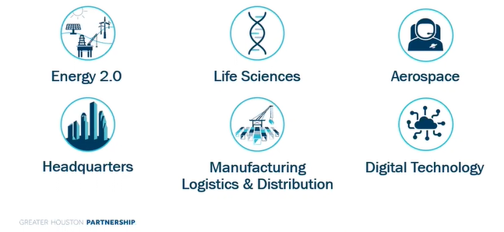
Top Industries in Houston
From energy and life sciences to manufacturing and aerospace, the Houston region offers a dynamic infrastructure to support these thriving, core industries

Slide 17
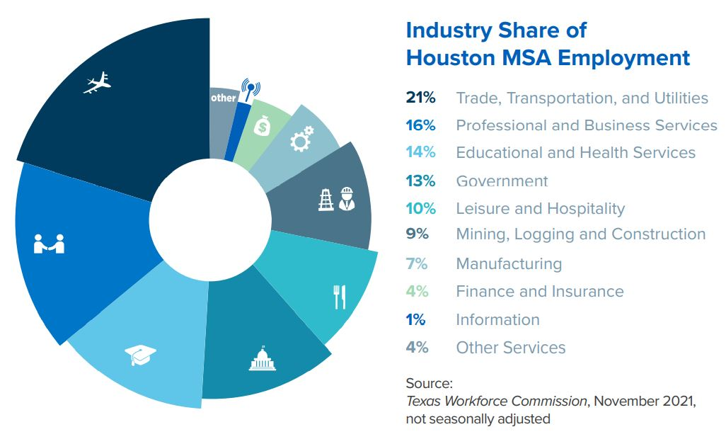

Slide 18
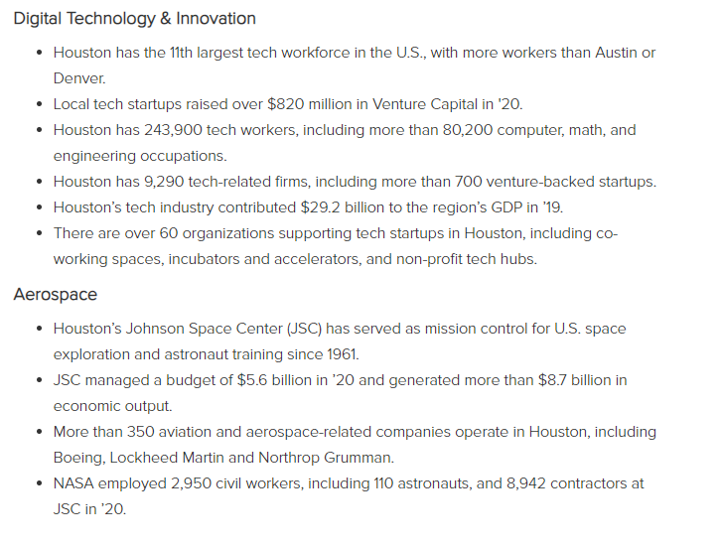

Slide 19
